Slide 1
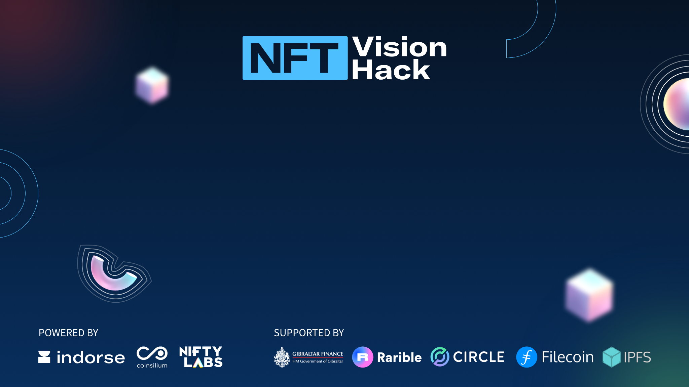
NFT Vision Hack
The Misfits

Slide 2
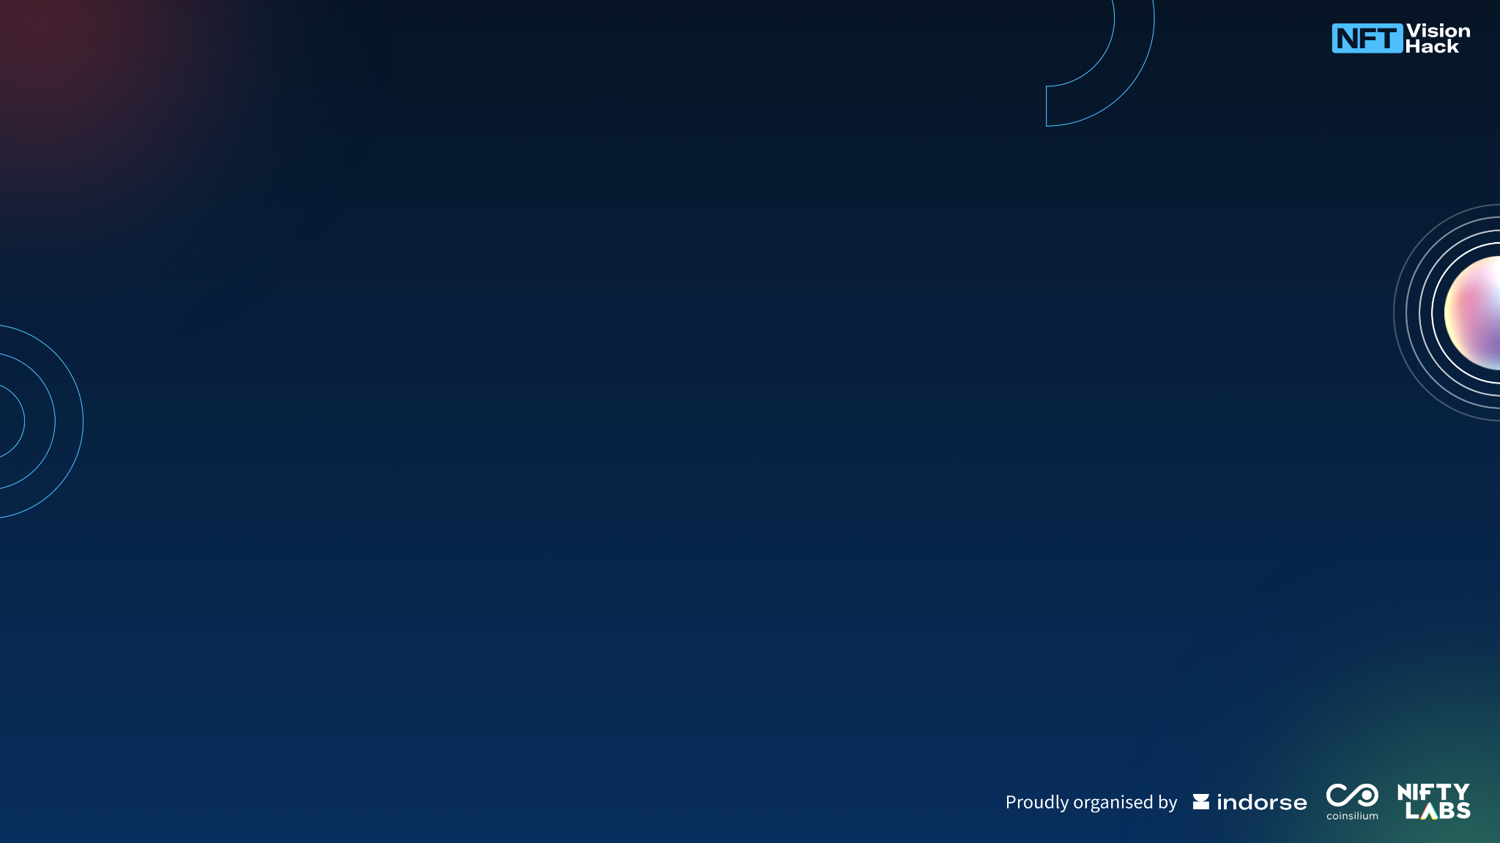
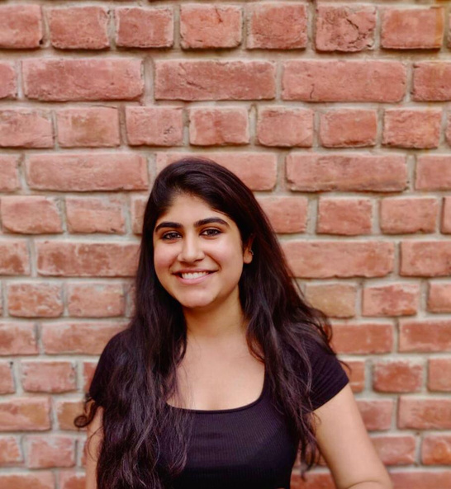
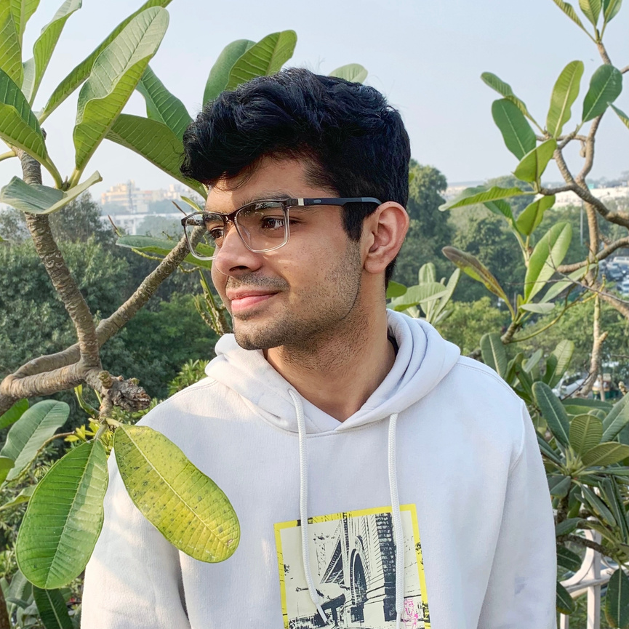
Introduction
…and we are the crazy ones, the misfits, the rebels, the troublemakers. The round pegs in the square holes.

Slide 3
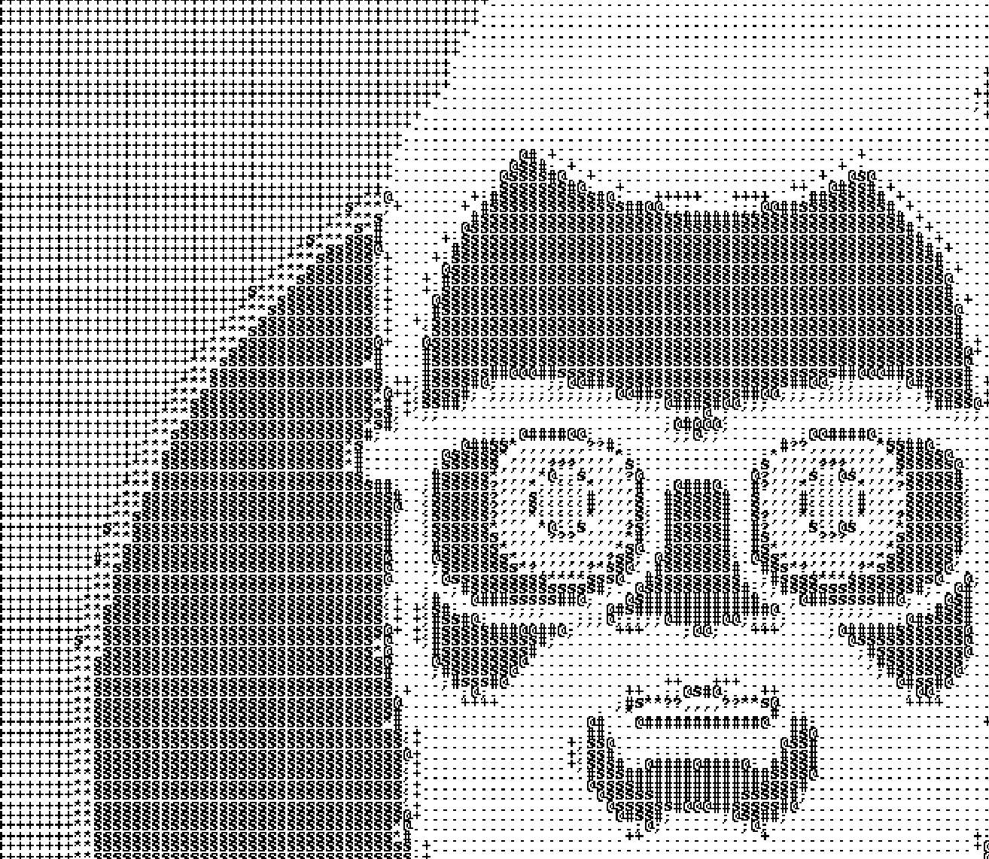
Track of choice
A scalable NFT art project by Indorse

Slide 4
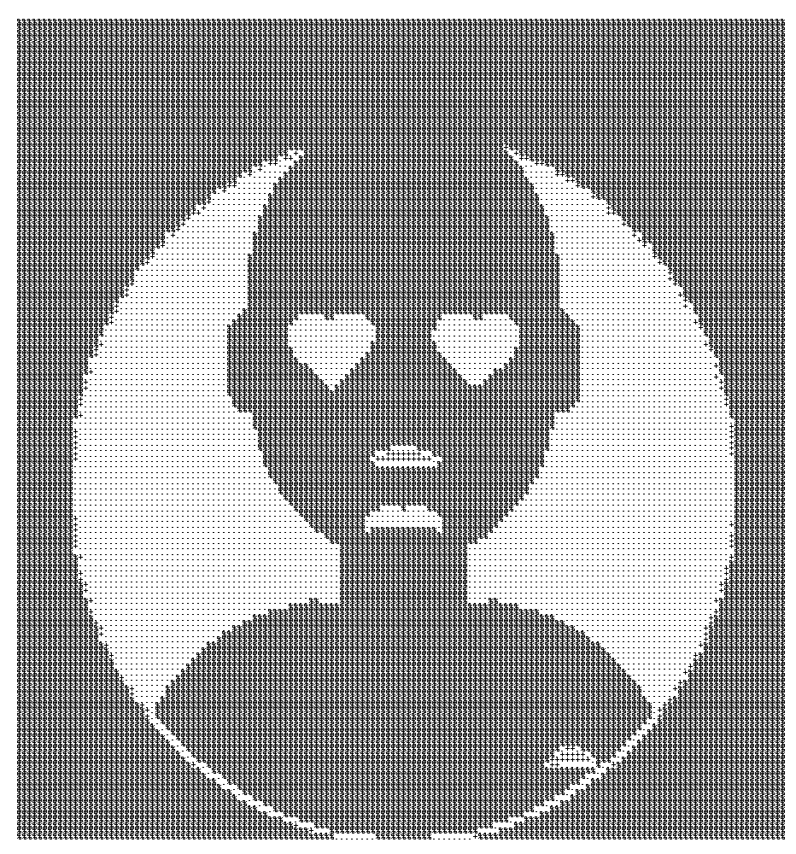
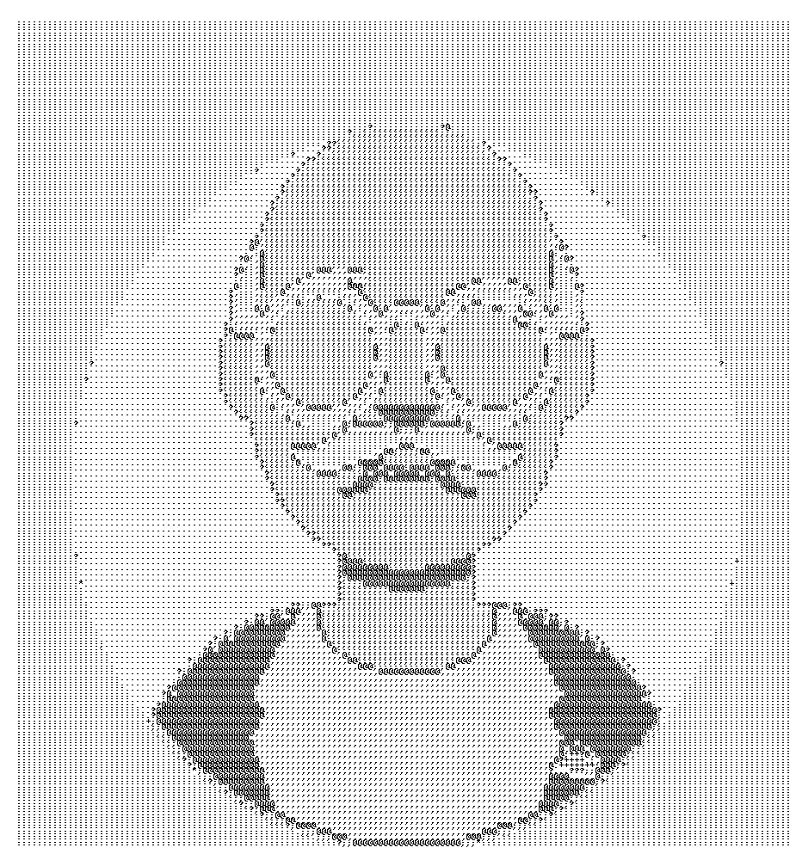
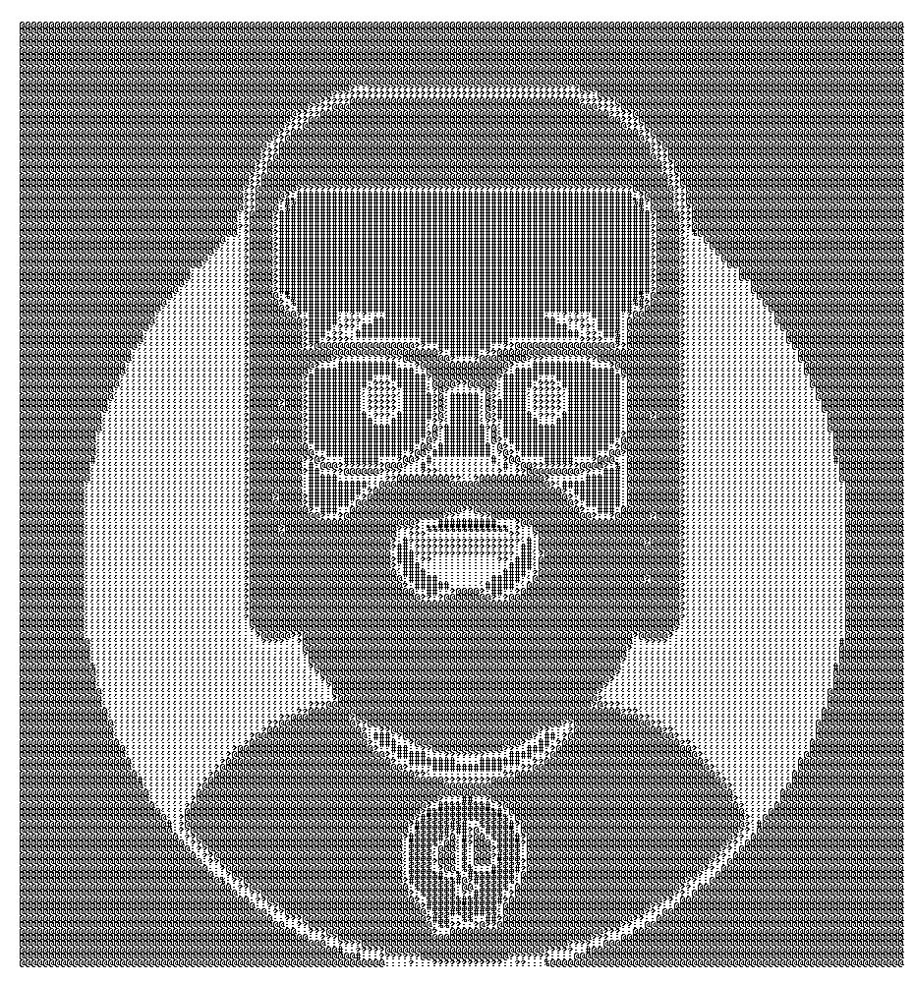
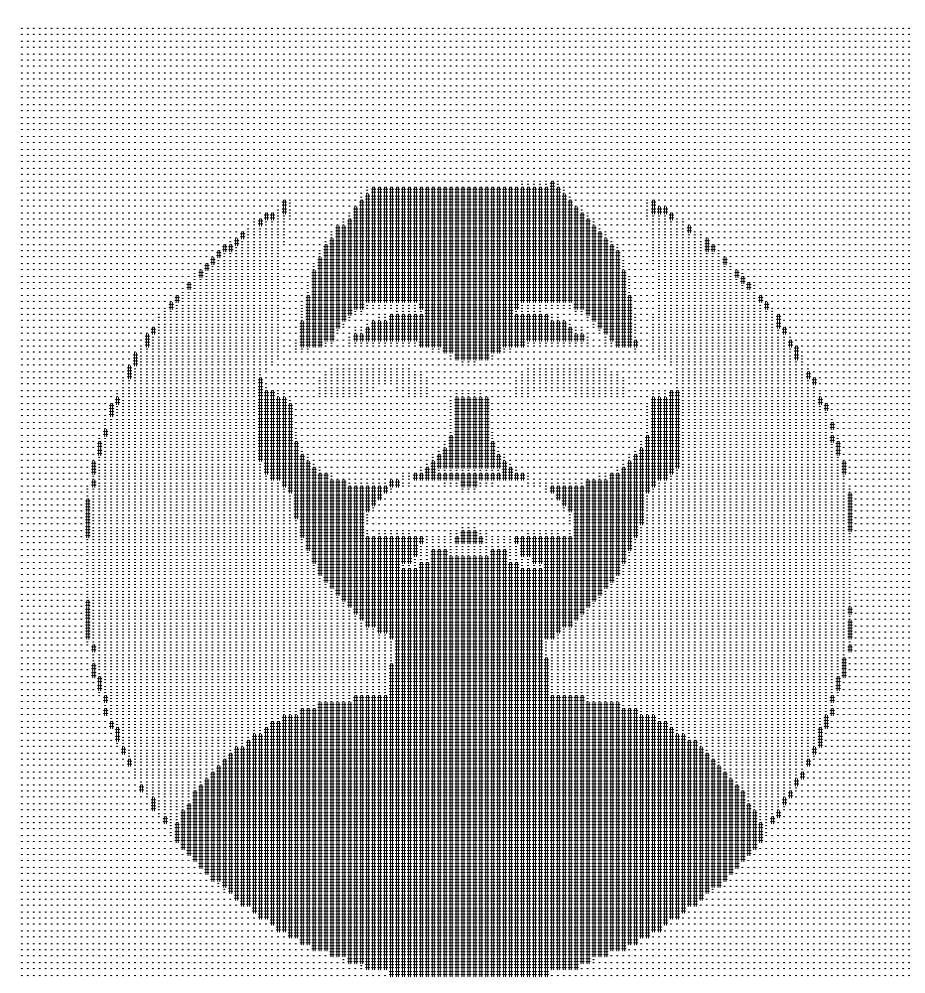
Project - AvataaarX
AvataaarX is an ASCII-based collection of virtual avatars generated using the open-source library of the same name by Pablo Stanley.
ASCII-based art is a popular trend amongst the nerdy folk. Our collection generates unique avatars and transforms them into ASCII-based grayscale art. Each avatar is unique with several distinguishing traits like clothing, eyes, skin tone, hair colour, head accessories, eye and eyebrow types, different type of facial expressions, clothes etc. The ASCII interpretation of this famed library is to add a spice of geekiness to the mix.
Each AvataaarX is not only a unique avatar with different visual traits, the ASCII characters used to draw the avatar are also randomly chosen from a list of possible characters. From diverse avatars using several different characters like - ! @ # $ % etc. to avatars using just a single character, AvataaarX has got one for everyone.

Slide 5
Technology & Tech Stack
Using a Python script, random avatars are generated. With the help of image processing libraries, the image data is converted to ASCII characters. The number of characters used are chosen randomly – higher number leads to more detailed images. This generated ASCII text is then converted and exported as an image that denotes the AvataaarX NFTs.
All libraries used are free for personal and commercial use.

Slide 6
Scalability
Using only the varied avatar traits of the library can generate up to 8 billion unique avatars. On top of that, the permutation of ASCII character used takes the total possible creations to a degree of several tens more. Our technical implementation makes adjusting the permitted traits as easy as simply adding or removing the name from a list. As per production and required supply, the number of avatars can be capped or the number of traits considered can be decreased.
Due to the open-source nature of the underlying library, AvataaarsX can be easily modified simply by changing the underlying .SVG files to launch new collections in the future.
Unlike algorithmic art and GAN-generated artwork, AvataaarX creation is lightning fast.
No. of AvataaarsXs | Approximate time taken to generate
1,000 | 3 minutes
10,000 | 34 minutes

